Slide 1
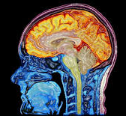
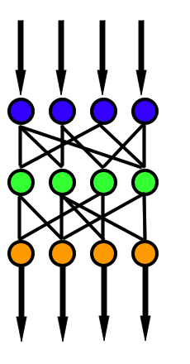
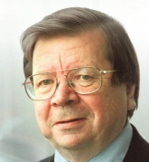
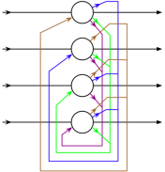
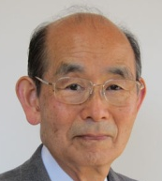
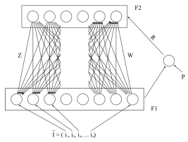
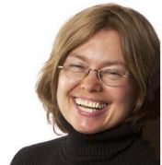
Brain-Based Computing:
Three Key Themes in Historical Evolution (1)
+
Multiple Representation Levels with Feedback
2-D Topographic Grids
Free Energy Minimization (Statistical Thermodynamics)
Self-Organizing Topology-Preserving Map (SOTPM, or SOM)
Perceptron
(no feedback)
1957
1982
Hopfield Neural Network
1981
Teuvo Kohonen
Frank Rosenblatt
Multilayer Perceptron with Back-Propagation
Neocognitron
John Hopfield
1980
1974
Simulated Annealing (A Learning Method)
Kunihiko Fukushima
1985
Paul Werbos
Adaptive Resonance Theory
David Ackley
1987
Boltzmann Machine
1986
Geoffrey Hinton
Steve Grossberg & Gail Carpenter
Terry Sejnowski
Hinton & Sejnowski
Alianna J. Maren, 2016. www.aliannajmaren.com

Slide 2
Image Sources
Image of brain
http://www.psypost.org/2014/04/brain-cell-discovery-could-open-doors-to-targeted-cancer-therapies-24319
https://en.wikipedia.org/wiki/Feedforward_neural_network
Geoffrey Hinton
https://en.wikipedia.org/wiki/Geoffrey_Hinton
Teuvo Kohonen
By Mcld - Own work, CC BY-SA 3.0, https://commons.wikimedia.org/w/index.php?curid=10373592
http://www.hs.fi/tiede/a1396751388580
Paul Werbos
https://en.wikipedia.org/wiki/Feedforward_neural_network
http://www.werbos.com/
John Hopfield
https://en.wikipedia.org/wiki/Hopfield_network#/media/File:Hopfield-net.png
https://pni.princeton.edu/faculty/john-hopfield
Kunihiko Fukushima
https://en.wikipedia.org/wiki/Adaptive_resonance_theory
http://personalpage.flsi.or.jp/fukushima/index-e.html

Slide 3
Image Sources
David H. Ackley
All images are from Creative Commons (including Wikipedia), or from institutional websites or from privately-hosted websites where the researcher has self-posted a picture. The only exception is the picture of Frank Rosenblatt, circa 1950’s – 1960’s, attribution unknown.
http://www.cs.unm.edu/~ackley/
Terry Sejnowski
http://www.salk.edu/scientist/terrence-sejnowski/
Gail Carpenter
http://techlab.bu.edu/members/gail/
Steve Grossberg
https://en.wikipedia.org/wiki/Stephen_Grossberg
Frank Rosenblatt
http://csis.pace.edu/~ctappert/srd2011/rosenblatt-contributions.htm

